Slide 1
NEXT WORD PREDICTON
18BCP071 - Niti Bhagat
18BCP028 - Dhruv Bosamia
18BCP068 – Nirmal Mahtea
18BCP132 – Yash Joshi

Slide 2
INTRODUCTION
Next word prediction model is an application which is trained on large amount of text data to predict next word based on previous words.
For e.g.
“ The grass is always … ”
The next word is “green” and could be predicted by most models and networks.

Slide 3
Problem statement
Given any input word and text file, predict the next word that can occur after the input word in the text file.

Slide 4
DATASET
https://www.gutenberg.org/cache/epub/5200/pg5200.txt

Slide 5
Methodologies That Can Be Used:
Next Word Prediction can be done by 2 approaches : 1. Using LSTM Model 2. Using N-gram Model.
N-gram model is based on probablity i.e What is the probablity of next word given previous word.
From various research paper it was concluded that LSTM model gave better accuracy then N-gram model. Hence we have used LSTM model.

Slide 6
Methodology Used:
Step 1 :- Importing important libraries such as numpy , keras.
Step 2 :- Cleaning the Data like removing punctuations etc.
Step 3 :- Converting words into numbers using Tokenization.
Step 4 :- Create sequences of words to fit the model with 1 word as input and 1 word as output.

Slide 7
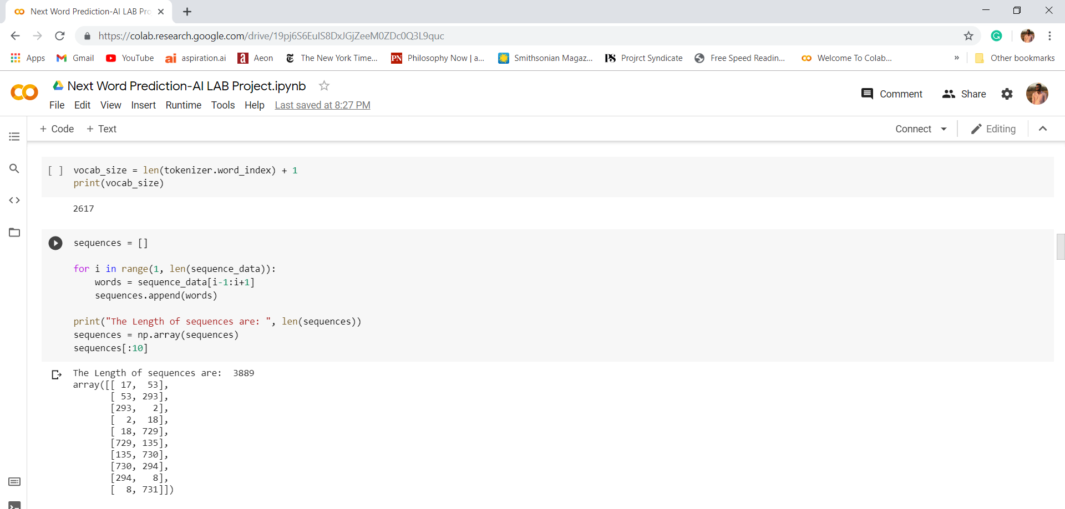

Slide 8
Step 5 :- Creating two elements X(input) and Y(output) and applying one hot encoding on output.
Step 6 :- Creating LSTM model
Step 7 :- Compiling the model
Step 8 :- Fitting the model and running 150 epochs for maximum accuracy.
Step 9 :- Loading the model and tokenizer and finally predict the next word.

Slide 9
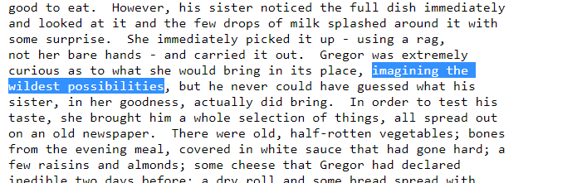
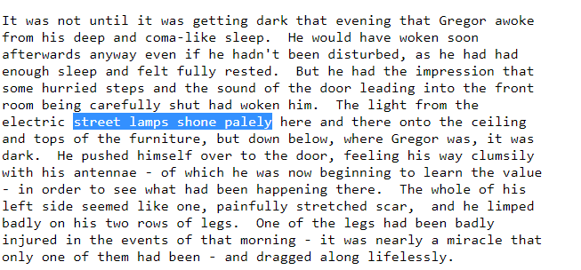
Results

Slide 10
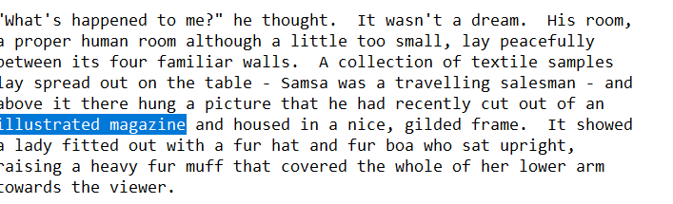
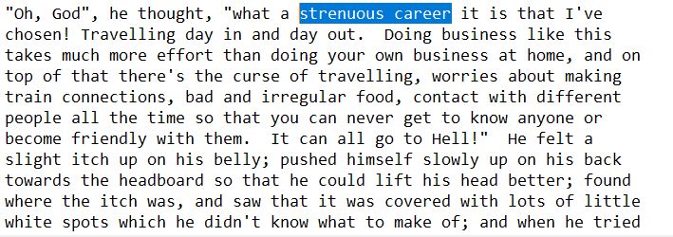
These are the images in dataset and it has highlighted 2 words such that if 1st word is input next word would be output

Slide 11
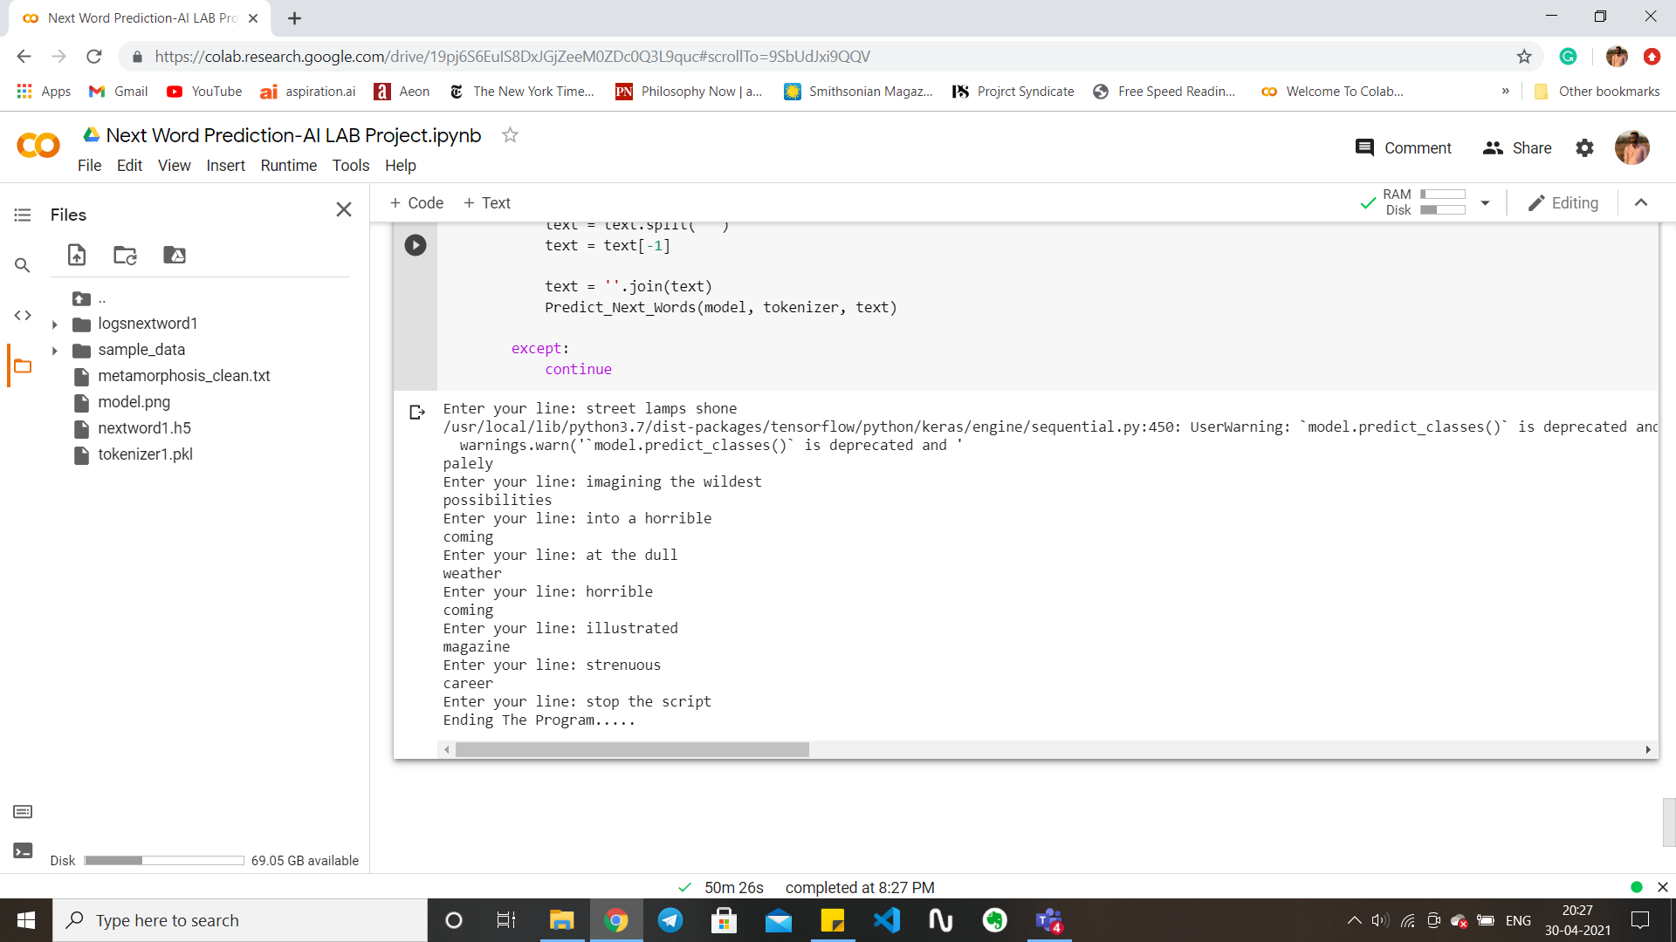
These are the results predicted be the Next Word Predictor of above given words of dataset.

Slide 12
Github Link :
https://github.com/Nirmal235/Next-word-Prediction

Slide 13
Thank You

